Slide 1

Define Model in Reinforcement Learning
Notes:
1

Slide 2
Objectives
Describe what a model is and how they can be used
Classify models as distribution models or sample models
Identify when to use a distribution model or sample model
Describe the advantages and disadvantages of sample models and distribution models
Define model
2
Notes:
2

Slide 3
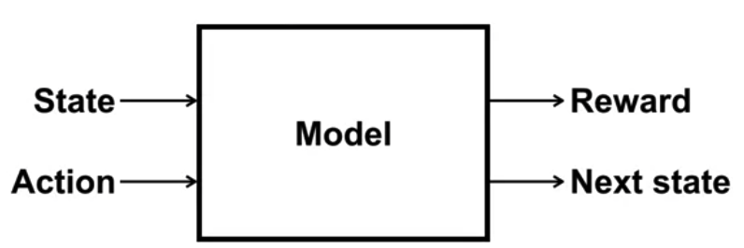
What is a Model?
Models are used to store knowledge about the dynamics.
From a particular state in action, the model should produce a possible next state and reward.
This allows us to see an outcome of an action without having to actually take it.
Define model
3
Notes:
3

Slide 4
What is a Model?
In the context of reinforcement learning, a model refers to a simplified representation of the environment that allows the agent to simulate and predict the outcomes of its actions without interacting directly with the real environment.
In other words, a model provides a way for the agent to estimate the consequences of its actions before actually executing them.
Define model
4
Notes:
4

Slide 5
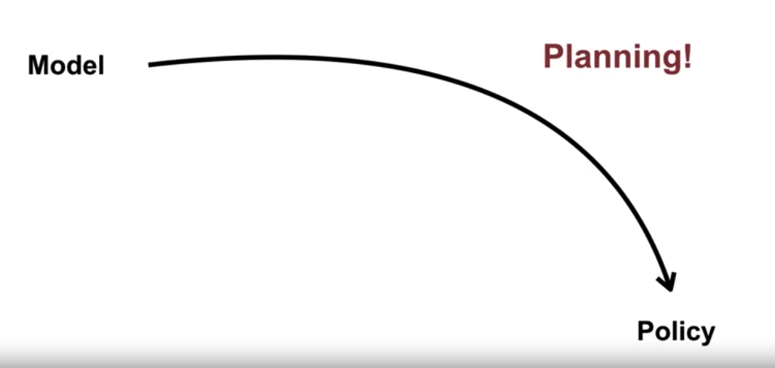
What is a Model?
A model allows for planning. Planning refers to the process of using a model to improve a policy
Define model
5
Notes:
5

Slide 6
What is a Model?
One way to plan with a model is to use simulated experience and perform value function updates as if those experiences happened.
By improving the value estimates, we can make more informed decisions.
Simulating experience improves the sample efficiency.
The addition of simulated experience means the agent needs fewer interactions with the world to come up with the same policy
Define model
6
Notes:
6

Slide 7
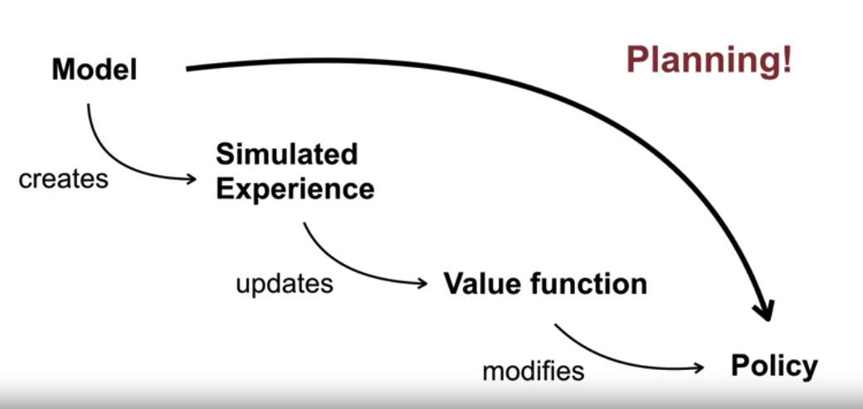
What is a Model?
Models are used for planning
Define model
7
Notes:
7

Slide 8
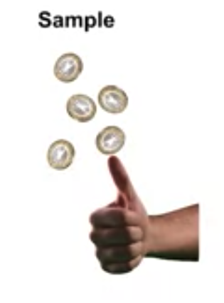
Model Types
Sample model, which produces an actual outcome drawn from some underlying probabilities.
For example, a sample model for flipping a coin can generate a random sequence of heads and tails.
Define model
8
Notes:
8

Slide 9
Model Types
Sample Model:
Description: A sample model provides specific samples or instances of the next state and reward for a given state-action pair.
Implementation: Instead of providing a probability distribution over all possible next states and rewards, a sample model generates actual samples based on the transition dynamics of the environment.
Example: In a sample model for a gridworld environment, when the agent takes an action in a particular state, the sample model directly provides a specific next state and reward based on the environment's transition probabilities.
Define model
9
Notes:
9

Slide 10
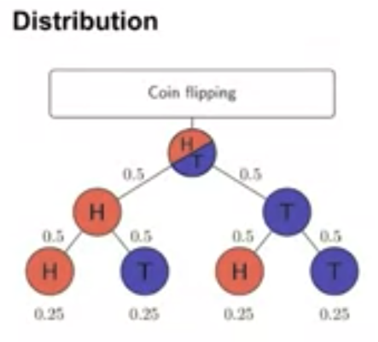
Model Types
Distribution model which completely specifies the likelihood or probability of every outcome.
In the coin flipping example, it would say that heads could occur 50 percent of the time and that tails could occur 50 percent of the time.
It could also produce the odds of any sequence of heads and tails using this information.
Define model
10
Notes:
10

Slide 11
Model Types
Distribution Model:
Description: A distribution model provides a probability distribution over all possible next states and rewards for a given state-action pair.
Implementation: Instead of providing specific samples, a distribution model represents the uncertainty of the environment's dynamics by assigning probabilities to each possible outcome.
Example: In a distribution model for a gridworld environment, when the agent takes an action in a particular state, the distribution model specifies the probabilities of transitioning to each neighboring state and receiving each possible reward.
Define model
11
Notes:
11

Slide 12
Model Types
Sample models can be computationally inexpensive because random outcomes can be produced according to a set of rules.
For example, to flip five coins, a sample model can randomly pick zero or one independently five times.
It only needs to produce a single outcome for each flip
Define model
12
Notes:
12

Slide 13
Model Types
Distribution models contain more information, but can be difficult to specify and can become very large.
The example for flipping five coin: the distribution model would enumerate every possible sequence of heads and tails you could get across the five coins and assign a probability to each sequence.
For this simple problem, that would consist of fully describing 32 possible outcomes.
Define model
13
Notes:
13

Slide 14
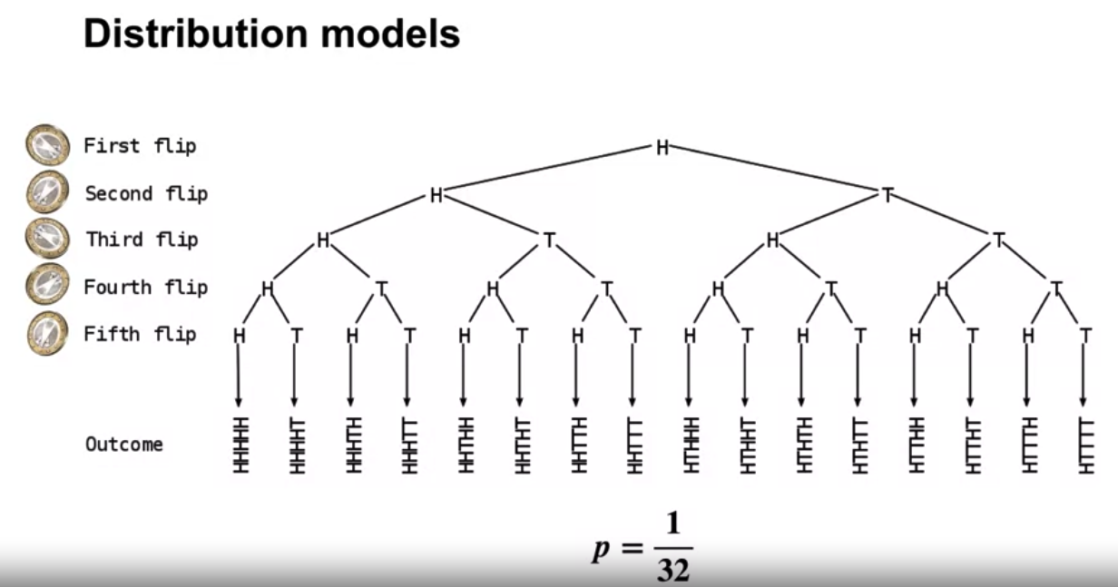
Model Types
Distribution models
Define model
14
Notes:
14

Slide 15
Sample vs Distribution Models
Sample models and distribution models are both types of models used in reinforcement learning to represent the environment's dynamics.
Sample models provide specific instances of next states and rewards, while distribution models represent probability distributions over all possible outcomes.
The choice between them depends on the characteristics of the environment and the specific requirements of the reinforcement learning problem.
Define model
15
Notes:
15

Slide 16
Sample vs Distribution Models
Representation: Sample models represent specific instances of next states and rewards, while distribution models represent probability distributions over all possible outcomes.
Uncertainty: Sample models do not explicitly capture uncertainty in the environment's dynamics, whereas distribution models provide a measure of uncertainty through probability distributions.
Define model
16
Notes:
16

Slide 17
Sample vs Distribution Models
Efficiency: Sample models can be more memory-intensive and less efficient to compute compared to distribution models, especially in environments with large state and action spaces.
Applicability: Sample models are often used in deterministic environments or when exact samples are readily available, while distribution models are more suitable for stochastic environments or when uncertainty needs to be explicitly accounted for.
Define model
17
Notes:
17

Slide 18
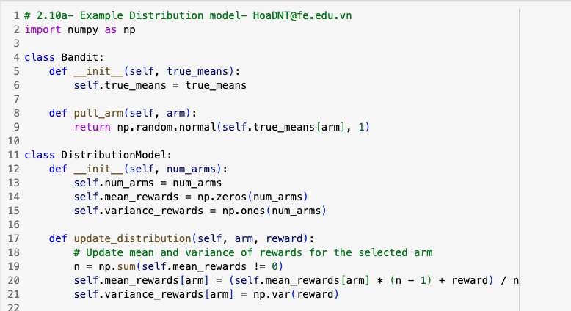
Distribution Models Example
Example of a distribution model for a two-armed bandit problem to represent and update probability distributions of rewards
Define model
18
Notes:
18

Slide 19
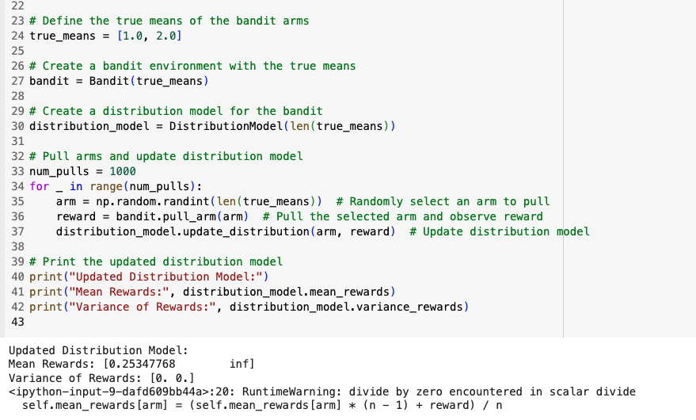
Distribution Models Example
Define model
19
Notes:
19

Slide 20
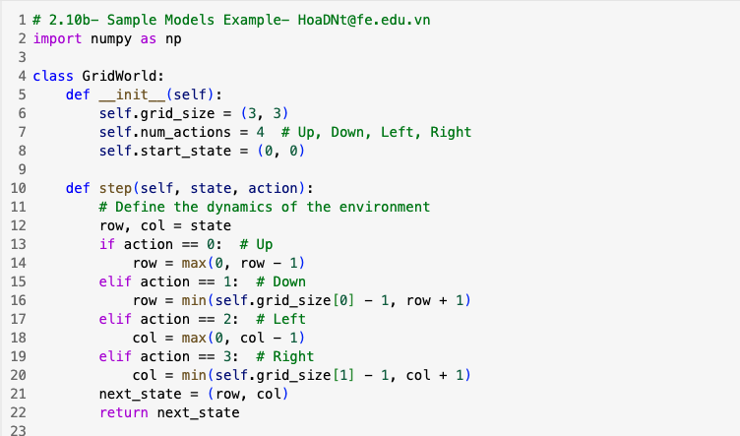
Sample Models Example
Example of a sample model for a simple grid world environment
Define model
20
Notes:
20

Slide 21
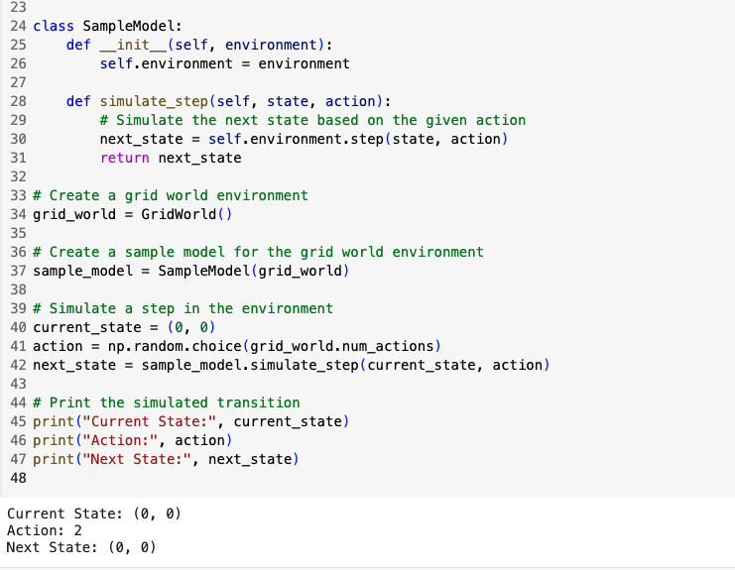
Sample Models Example
Define model
21
Notes:
21

Slide 22
Summary
Describe what a model is and how they can be used
Classify models as distribution models or sample models
Identify when to use a distribution model or sample model
Describe the advantages and disadvantages of sample models and distribution models
Define model
22

Slide 23
Q & A
Define model
23

